Slide 1
Employee Data Analysis using Excel
Student Name : D Divyalakshmi
Register No : 22CO11
Department : B.Com 3rd Year
College : Thirumurugan Arts And Science

Slide 2
PROJECT TITLE
Employee Performance Analysis using Excel

Slide 3


AGENDA
Problem Statement
Project Overview
End Users
Our Solution and Proposition
Dataset Description
Modelling Approach
Results and Discussion
Conclusion
3/21/2024 Annual Review

Slide 4

PROBLEM STATEMENT
An employee information from is a document captures essential data about an employee , such as their full name address contact number , emergency contact social security number and other relevant personal details. It serves as a foundational record or each individual employee with in an organization

Slide 5

PROJECT OVERVIEW
Project Over View to find the Summary of an organization members and the employee skills, Performance, and the types of department and rolles

Slide 6
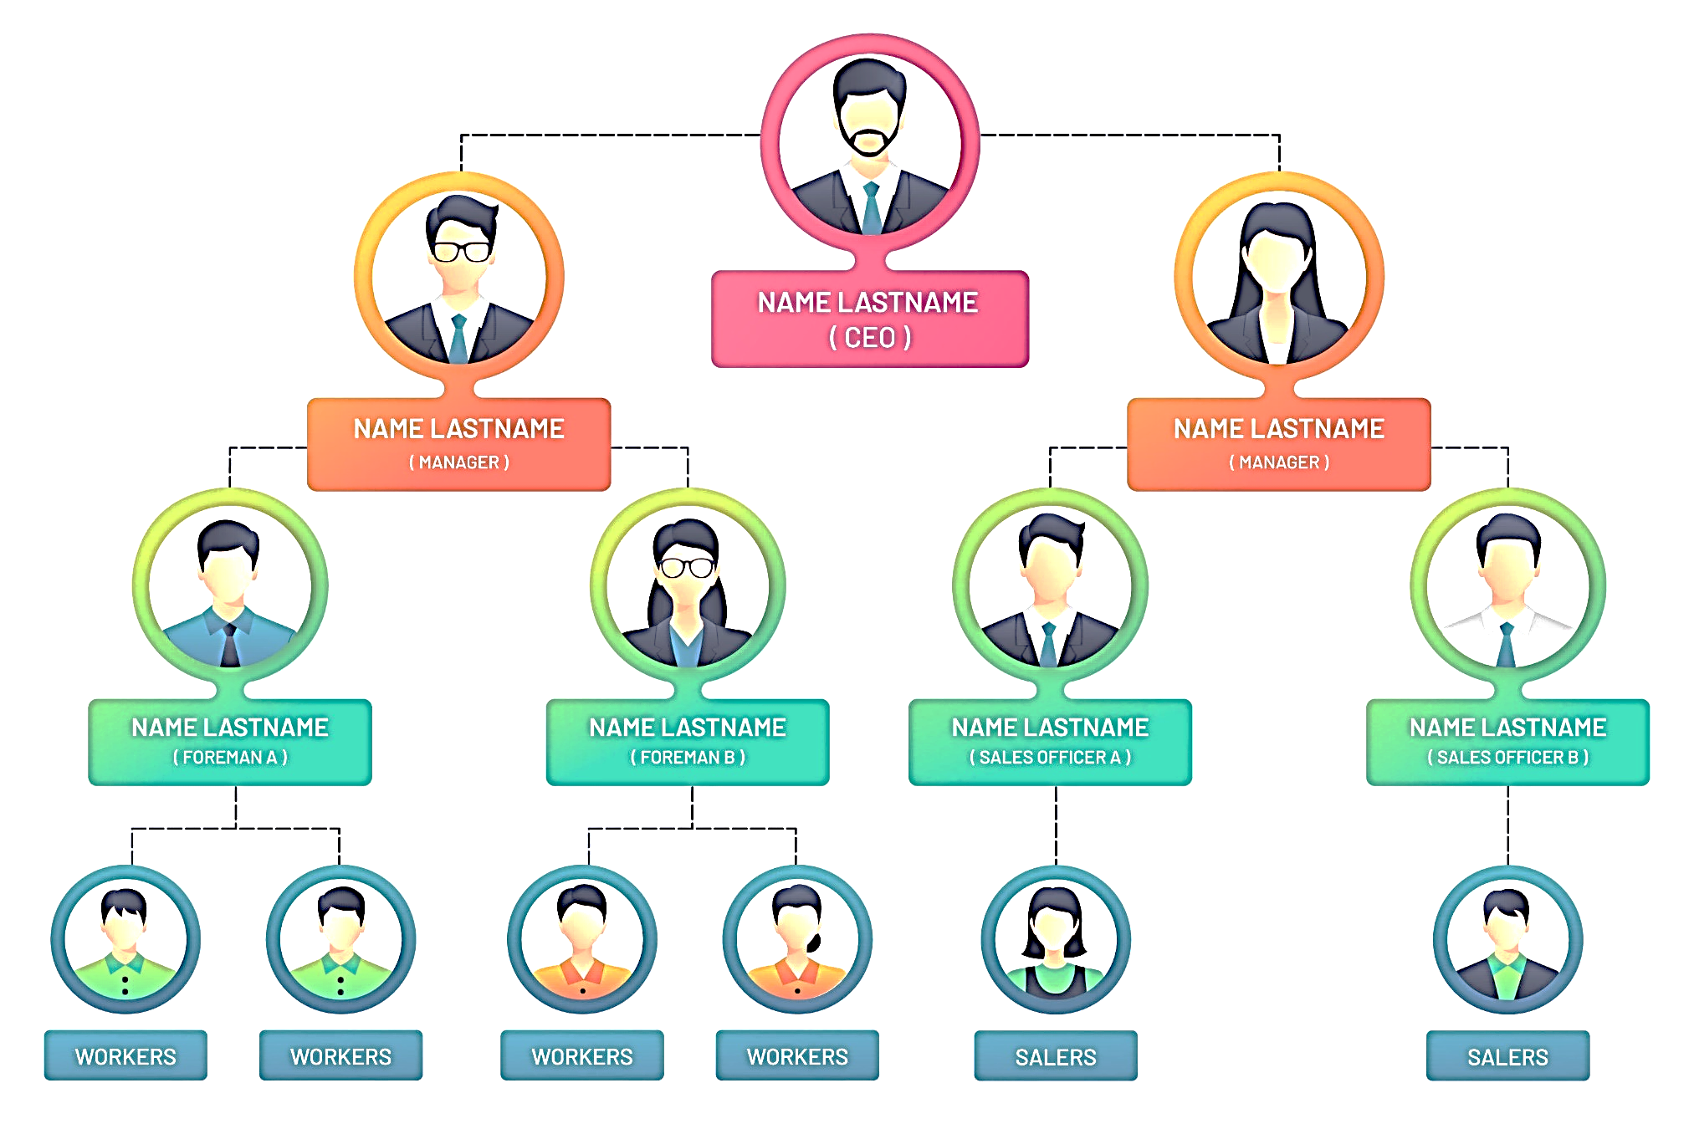


WHO ARE THE END USERS?

Slide 7

OUR SOLUTION AND ITS VALUE PROPOSITION
Conduction Formatting : Missing
Filter : Performance
Pivot Table : Summary
Graph : Data Visualization

Slide 8
Dataset Description
Employee : Kaggle
Features : Number
Emp ID : Text
Name : Text
Experience : Number
Gender : Male, Female
Department : Text

Slide 9

THE "WOW" IN OUR SOLUTION
Performance=
SERIES(Sheet3!$B$11,Sheet3!$A$12:$A$25,
Sheet3!$B$12:$B$25,1)
3/21/2024 Annual Review
9

Slide 10
MODELLING
Data Collection
Kaggle
Features Collection
Education
Employee Gender
City
Experience
Data Collection
Pivot Table
Graph
10

Slide 11
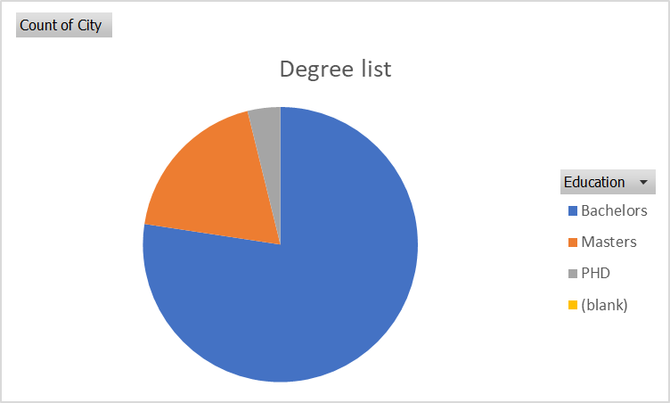
RESULTS
11

Slide 12
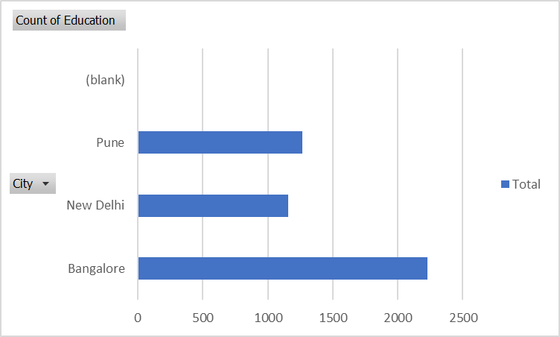
RESULTS
12

Slide 13
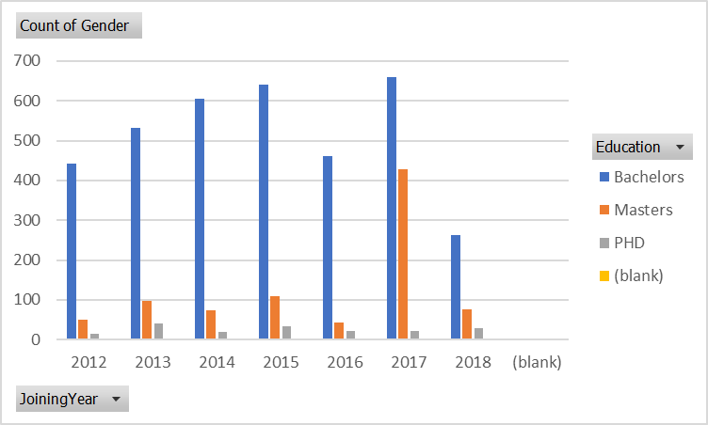
RESULTS
13

Slide 14
conclusion
The data used to Summary the employee, education , Gender, Department, Roles, and there key skills

